Slide 1
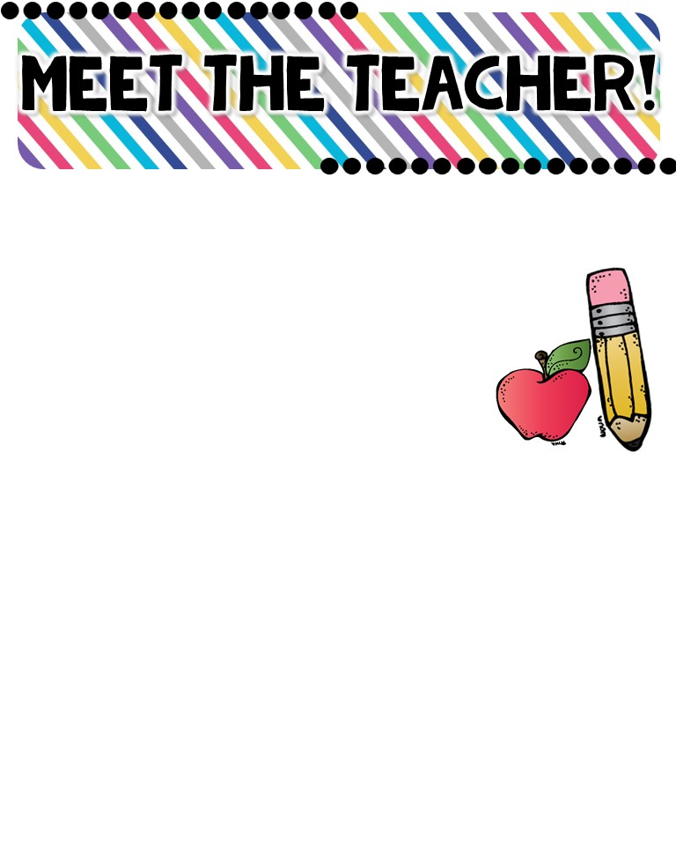
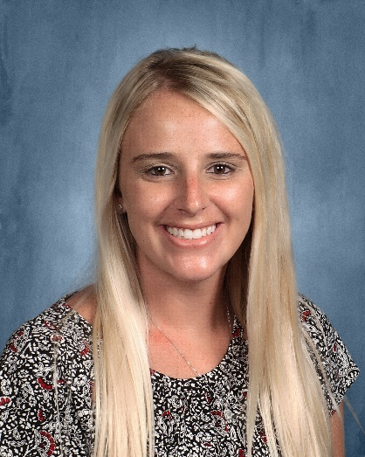
Mrs. Barnes
About Me!
Hello! My name is Kayla Barnes, and I am very excited to start my 7th year teaching! I am 31 years old, and I was born and raised in St. Louis. My husband and I have a beautiful daughter named Eleanor. I love to read, travel, hike, and spend time with my friends and family! I’m excited to make this my best year yet!
Fun Facts !
-My husband and I have been married for four years
-My daughter just turned 2!
-Baby brother due July 25th!
-I have 16 chickens
-I hatch chicks with my class each year
-I have two great danes
MY FAVORITES!
MY EDUCATION!
Movie: Sweet Home Alabama
Book: The Rainbow Fish
Color: Pink
Drink: Dr. Pepper
Season: Summer
Sports: Softball
Fast Food: Taco Bell
Subject: Reading
Store: Target
Place to Visit: Table Rock Lake
Candy: Skittles
Restaurant: Rich & Charlies
Birthday: July 4th
Webster University
-Bachelor of Science - Elementary Education
-Master of Education with an Emphasis in Reading
-Reading certification
CONTACT ME!
Email: Kayla.barnes@slps.org
Class Dojo Messenger
Buder Phone Number: 314.352.4343
My preferred method of communication for the quickest response is Class Dojo messenger.
BUDER ELEMENTARY SCHOOL: We are one team, inspiring each other every day, to grow in every way.

